Slide 1
Bag of Tricks
Slides from http://wangshusen.github.io/teaching/CS583A20Spring/index.html

Slide 2
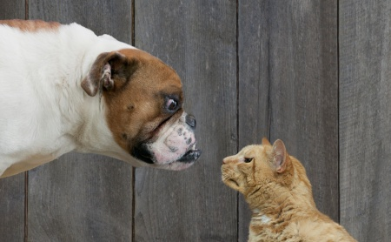
The Dogs vs. Cats Dataset
https://www.kaggle.com/c/dogs-vs-cats

Slide 3
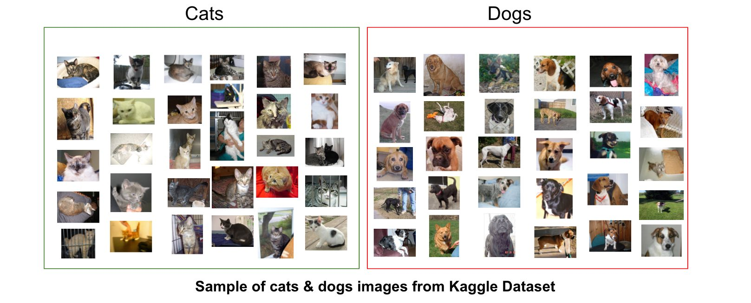
The Dogs vs. Cats Dataset

Slide 4
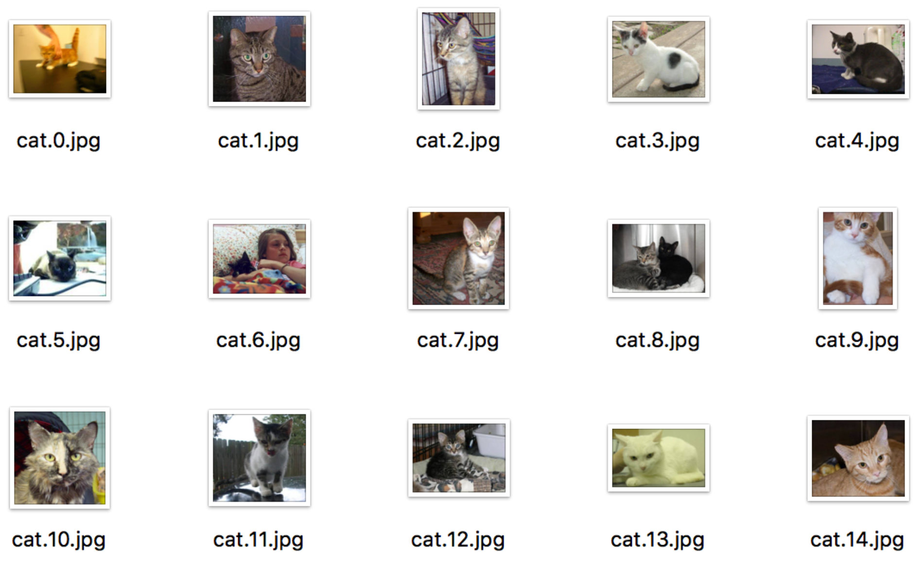
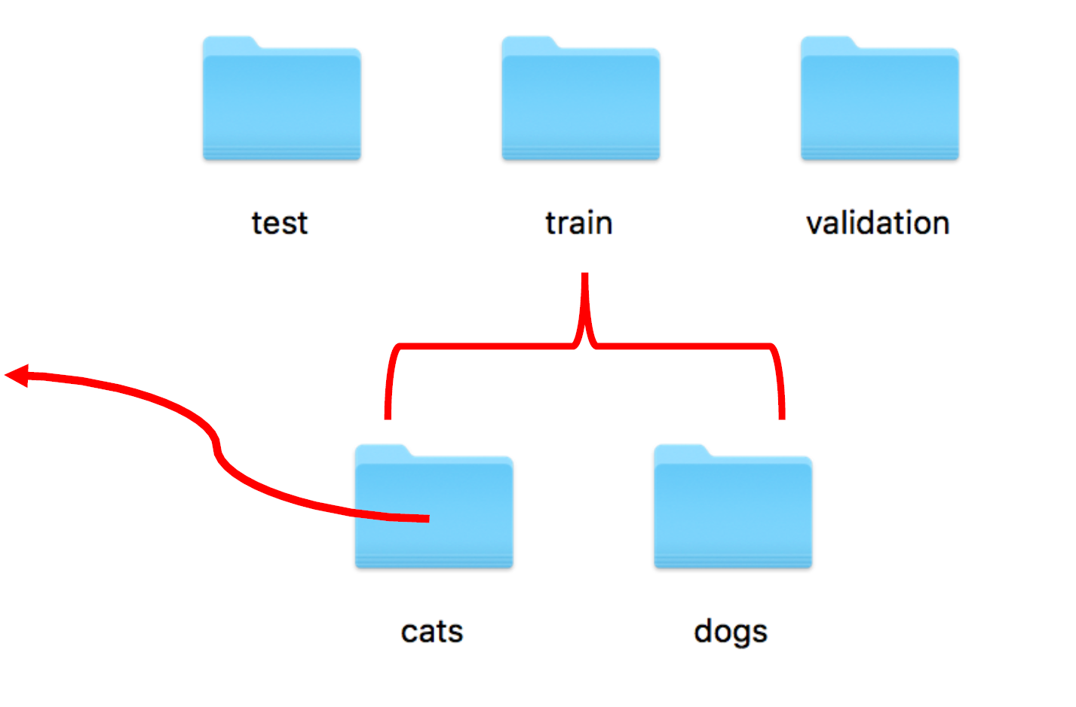
The Dogs vs. Cats Dataset
The dataset has 25,000 training samples

Slide 5
Implement a CNN Using PyTorch

Slide 6
1. Load and Process the Dataset
Currently, the data sit on a drive as JPEG files
Data processing:
Read the picture files
Decode the JPEG content to order-3 tensors.
Resize the images to the same shape, e.g., 150×150×3.
Rescale the pixel values (between 0 and 255) to the [0, 1] interval

Slide 7
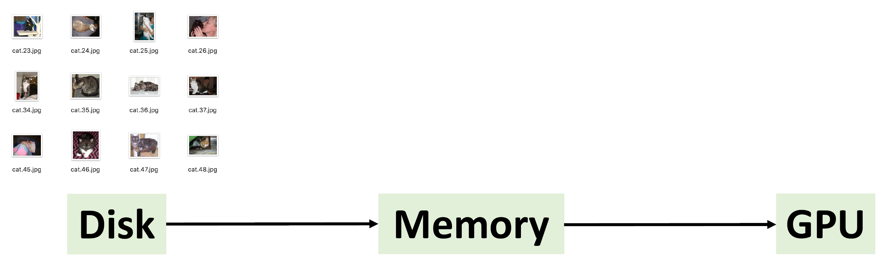
1. Load and Process the Dataset

Slide 8
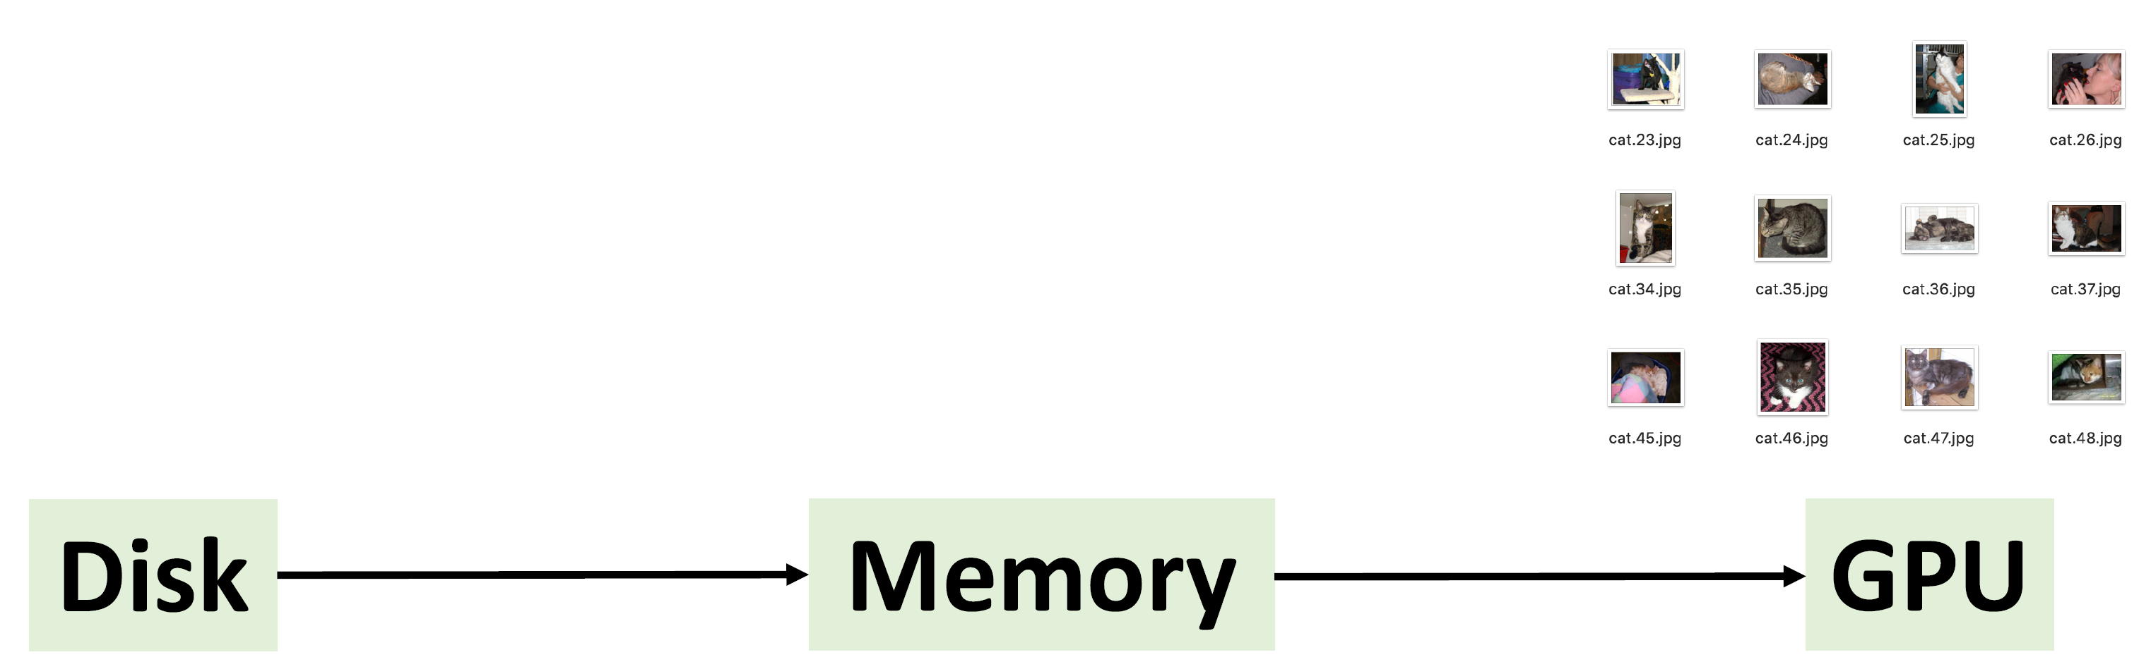
1. Load and Process the Dataset

Slide 9
2. Build the CNN
model = nn.Sequential(
nn.Conv2d(in_channels=3, out_channels=16, kernel_size=3),
nn.ReLU(),
nn.MaxPool2d(kernel_size=2),
nn.Conv2d(in_channels=16, out_channels=32, kernel_size=3),
nn.ReLU(),
nn.MaxPool2d(kernel_size=2),
nn.Conv2d(in_channels=32, out_channels=64, kernel_size=3),
nn.ReLU(),
nn.MaxPool2d(kernel_size=2),
nn.Flatten(),
nn.Linear(in_features=64*17*17, out_features=512),
nn.ReLU(),
nn.Linear(in_features=512, out_features=2),
).to(device)

Slide 10
3. Train the CNN
Optimization method
Learning rate (LR)
Loss function
Metric

Slide 11
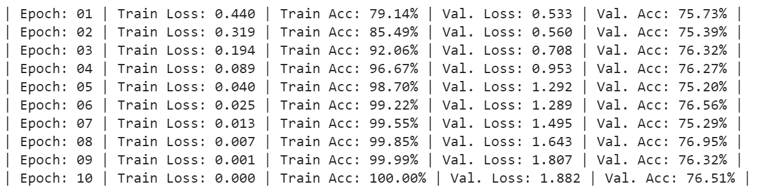
4. Examine the Results

Slide 12
Trick 1: Dropout

Slide 13

Dropout: Basic Idea
Train
Cripple neural network by removing hidden neurons stochastically
In each iteration of training (1 forward + 1 backward), randomly mask 50% (or an arbitrary percentage) of the neurons.

Slide 14
Dropout: Basic Idea
Train
Cripple neural network by removing hidden neurons stochastically
In each iteration of training (1 forward + 1 backward), randomly mask 50% (or an arbitrary percentage) of the neurons.
Predict
No dropout
Use all parameters
Replace the masks by their expectation
This is simply the constant vector 0.5 if dropout probability is 0.5

Slide 15
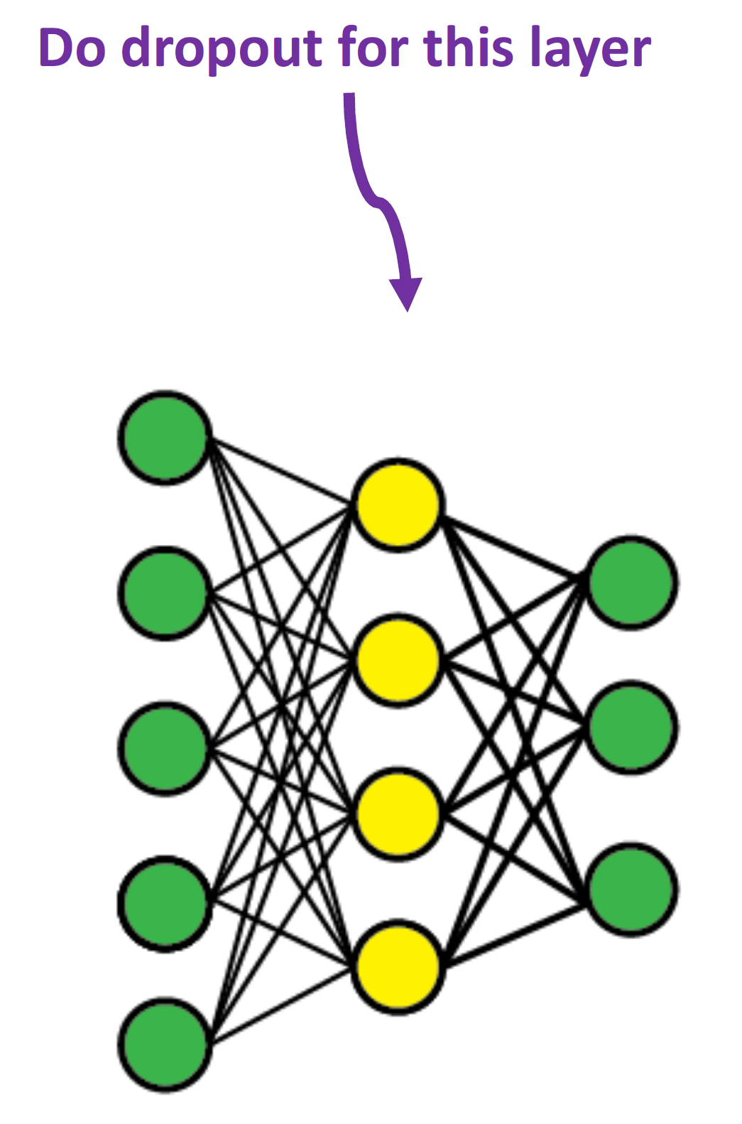
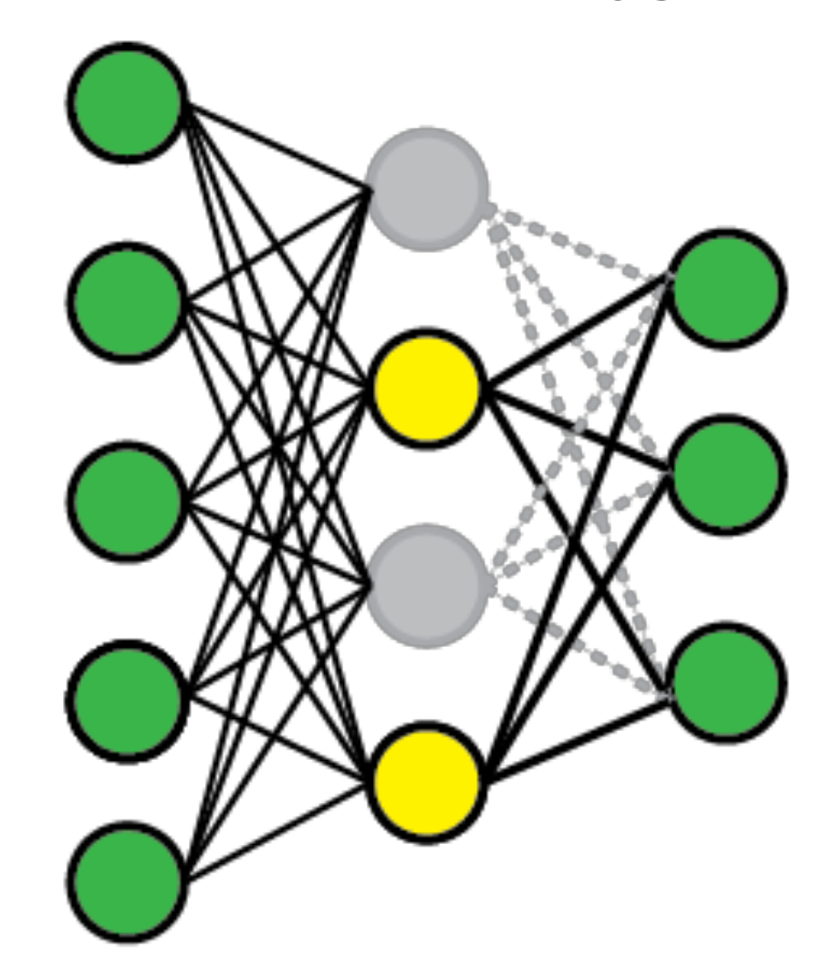
Dropout: Implementation
For a batch of training samples
Randomly choose 50% of the neurons
Set the selected neurons to zeros

Slide 16
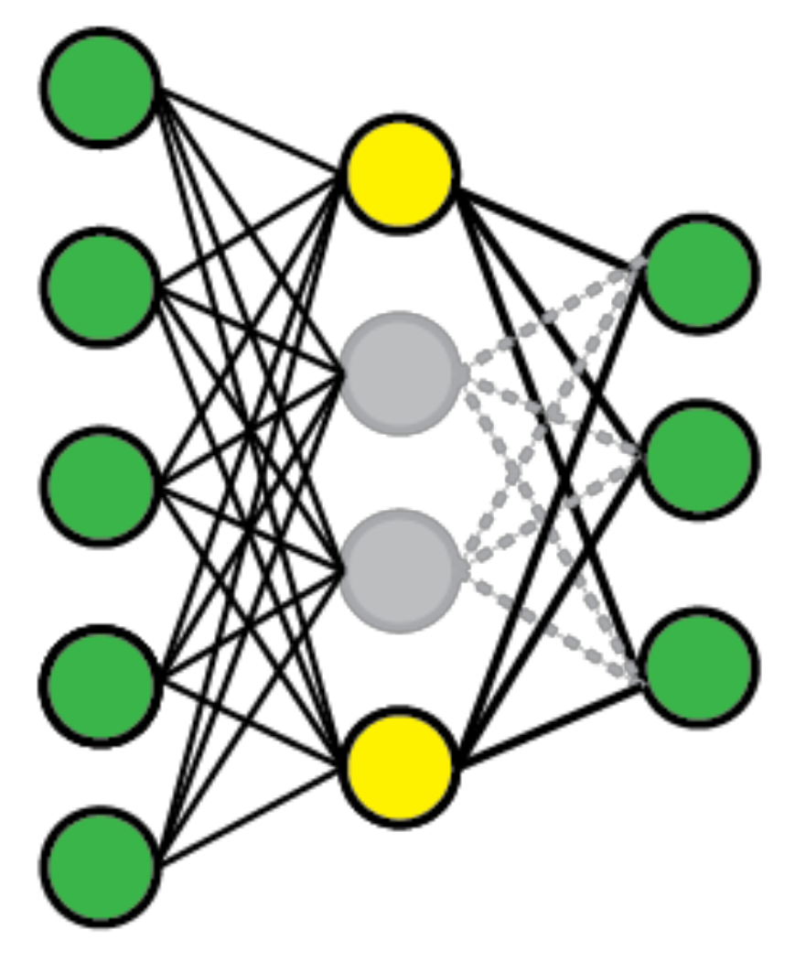
Dropout: Implementation
For a batch of training samples
For another batch, do an independent random sampling

Slide 17
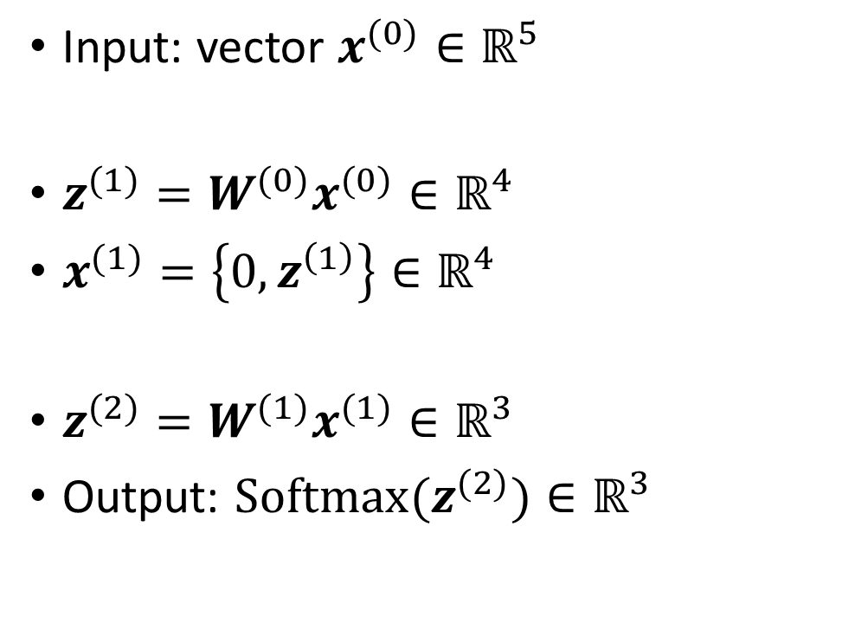
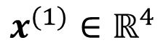
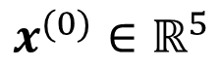
Dropout: Implementation
Input: vector $x^{(0)}∈ℝ^{5}$
${z^{(1)}=W^{(0)}x}^{(0)}∈ℝ^{4}$
$x^{(1)}=\left\{0,z^{\left(1\right)}\right\}∈ℝ^{4}$
${z^{(2)}=W^{(1)}x}^{(1)}∈ℝ^{3}$
Output: $Softmax(z^{(2)})∈ℝ^{3}$
$$x^{(0)}∈ℝ^{5}$$
$$x^{(1)}∈ℝ^{4}$$

Slide 18
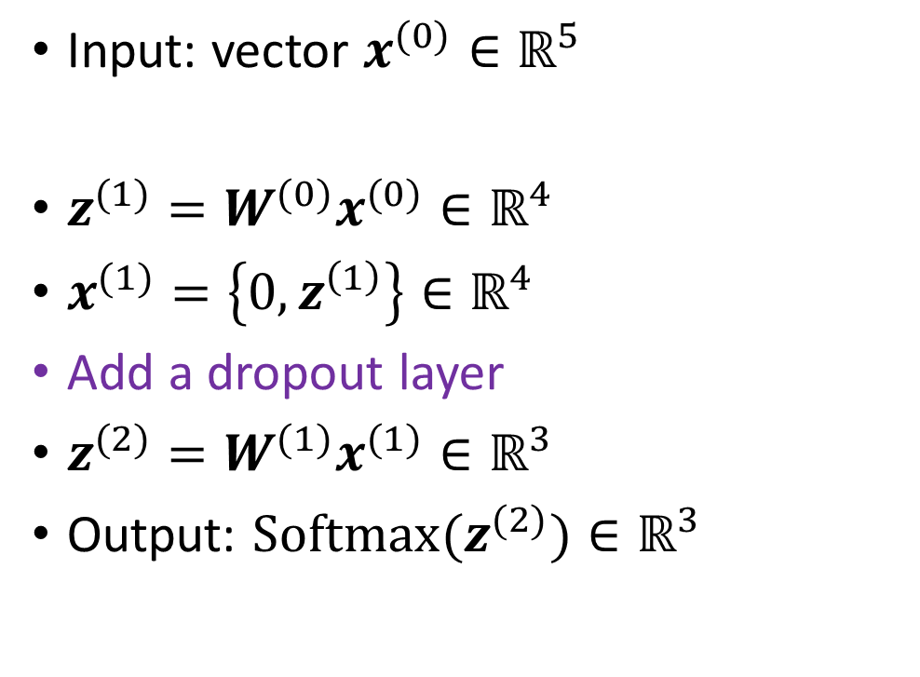
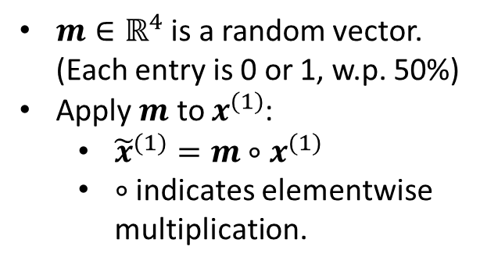
Dropout: Implementation
Input: vector $x^{(0)}∈ℝ^{5}$
${z^{(1)}=W^{(0)}x}^{(0)}∈ℝ^{4}$
$x^{(1)}=\left\{0,z^{\left(1\right)}\right\}∈ℝ^{4}$
Add a dropout layer
${z^{(2)}=W^{(1)}x}^{(1)}∈ℝ^{3}$
Output: $Softmax(z^{(2)})∈ℝ^{3}$
Regularize this layer
$m∈ℝ^{4}$ is a random vector. (Each entry is 0 or 1, w.p. 50%)
Apply $m$ to $x^{(1)}$:
${\tilde{x}}^{(1)}=m∘x^{(1)}$
$∘$ indicates elementwise multiplication.
$$x^{(0)}∈ℝ^{5}$$
$$x^{(1)}∈ℝ^{4}$$

Slide 19
Dropout Layer
model_with_dropout = nn.Sequential(
nn.Conv2d(in_channels=3, out_channels=16, kernel_size=3),
nn.ReLU(),
nn.MaxPool2d(kernel_size=2),
nn.Conv2d(in_channels=16, out_channels=32, kernel_size=3),
nn.ReLU(),
nn.MaxPool2d(kernel_size=2),
nn.Conv2d(in_channels=32, out_channels=64, kernel_size=3),
nn.ReLU(),
nn.MaxPool2d(kernel_size=2),
nn.Flatten(),
nn.Dropout(0.4),
nn.Linear(in_features=64*17*17, out_features=512),
nn.ReLU(),
nn.Linear(in_features=512, out_features=2),
).to(device)
Dropout to regularize the 1st dense layer.
Because the 1st dense layer has too many trainable parameters

Slide 20
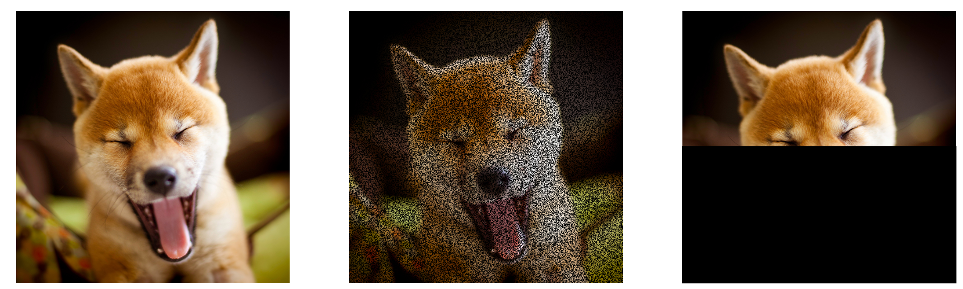
Why Does Dropout Work?
In training, dropout forces the network to make decision based on part of the features.

Slide 21
Why Does Dropout Work?
In training, dropout forces the network to make decision based on part of the features.
Dropout is a regularization [1]
Alleviate overfitting
Like the L1 and L2 norm regularizations
But dropout is empirically better
1. Wager, Wang, & Liang. Dropout Training as Adaptive Regularization. In NIPS, 2013.

Slide 22
Trick 2: Data Augmentation

Slide 23
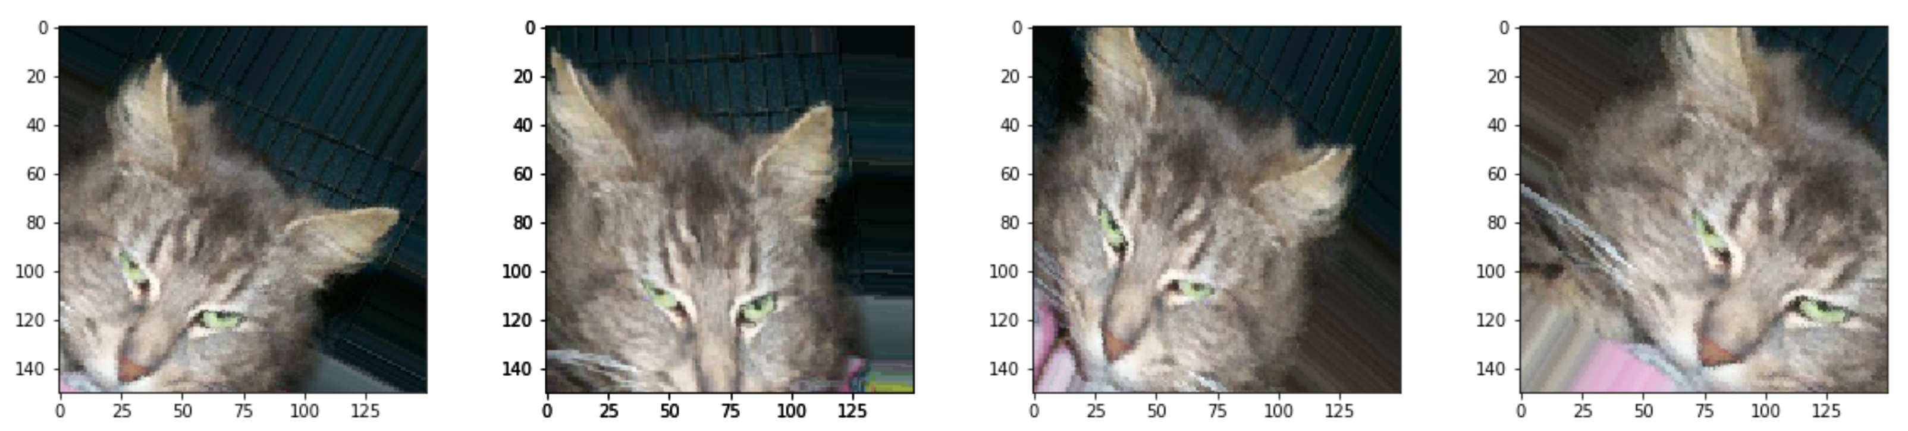
Data Augmentation
Data augmentation: generating more training samples from existing training data.
E.g., flip, rotation, crop, shift, add random noise

Slide 24
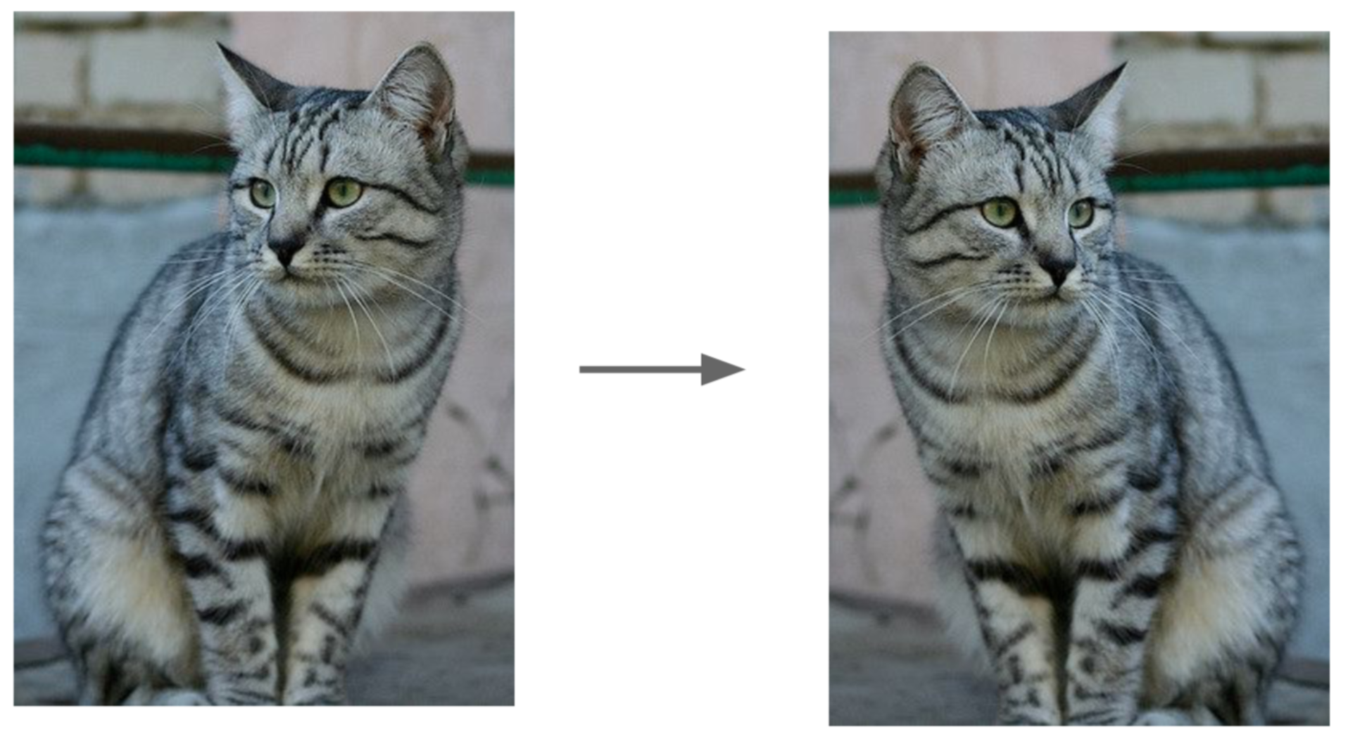
Data Augmentation: Example
Horizontal Flips

Slide 25
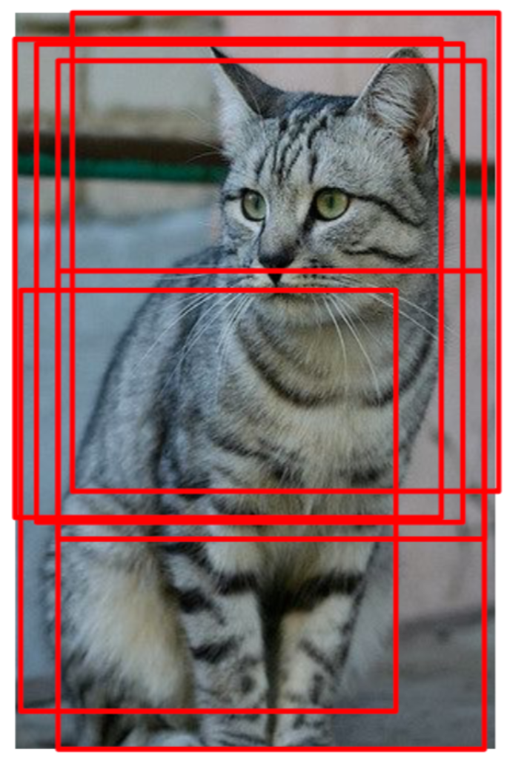
Data Augmentation: Example
Random crops and scales

Slide 26
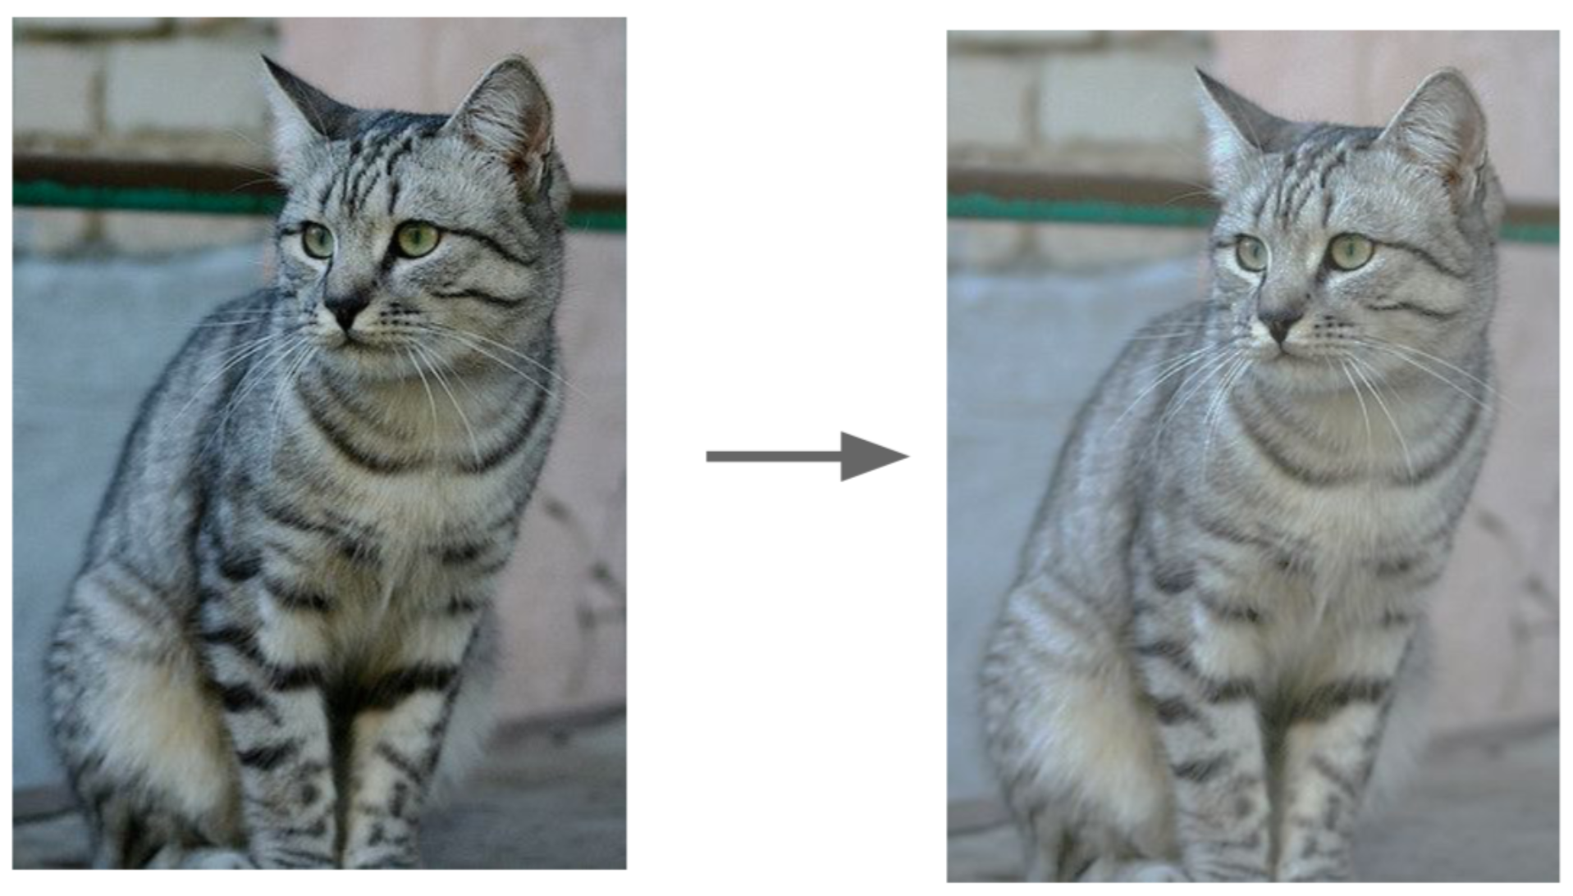
Data Augmentation: Example
Color Jitter (randomize contrast and brightness)

Slide 27
Take-Home Message
To train a CNN for images, always use data augmentation
It gives you more labeled data for free!
If a layer has too many parameters, put a dropout layer before it
Regularization prevents overfitting
The training becomes a little slower

Slide 28
Trick 3: Pretrain

Slide 29
Train a Deep Neural Network?
model = nn.Sequential(
nn.Conv2d(in_channels=3, out_channels=16, kernel_size=3),
nn.ReLU(),
nn.MaxPool2d(kernel_size=2),
nn.Conv2d(in_channels=16, out_channels=32, kernel_size=3),
nn.ReLU(),
nn.MaxPool2d(kernel_size=2),
nn.Conv2d(in_channels=32, out_channels=64, kernel_size=3),
nn.ReLU(),
nn.MaxPool2d(kernel_size=2),
nn.Flatten(),
nn.Linear(in_features=64*17*17, out_features=512),
nn.ReLU(),
nn.Linear(in_features=512, out_features=2),
).to(device)
We have trained a neural net with 3 Conv Layers and 2 FC Layers
Relatively shallow

Slide 30
Train a Deep Neural Network?
Can we train a deep neural network?
It is hard!
The number of parameters is huge
The deep network has a huge capacity
In most cases, we have limited training samples
Naively training a deep network will result in overfitting or bad optimization.

Slide 31
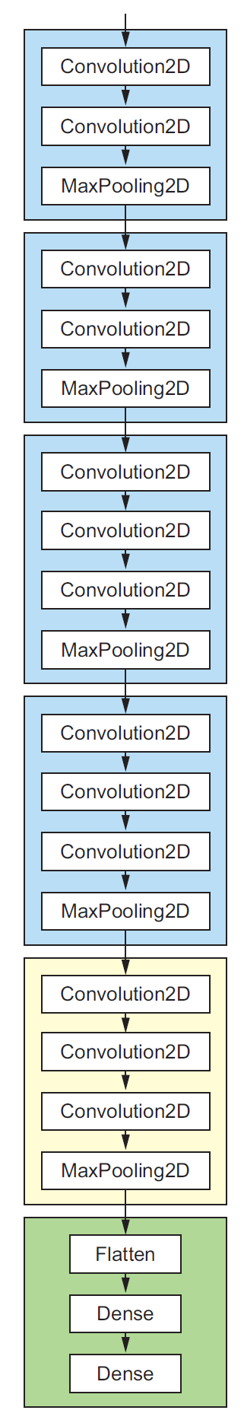
Train a Deep Neural Network?
VGG16 network
Can we train a deep neural network?
It is hard!
The number of parameters is huge
The deep network has a huge capacity
In most cases, we have limited training samples
Naively training a deep network will results in overfitting
Solution: pretrain

Slide 32
Pretrain
VGG16 network
Pre-train a deep net on large-scale dataset, e.g., ImageNet (14M images with labels)
Remove the top layers. Why?
Different output shapes and activation functions.
New classifier specialized for the new task.
Remove the top layers

Slide 33
Pretrain
Pre-train a deep net on large-scale dataset, e.g., ImageNet (14M images with labels)
Remove the top layers. Why?
Build the new top layers (random initialized)
Freeze the base layers; Train the top layers.
Freeze
Trainable

Slide 34
Pretrain
Pre-train a deep net on large-scale dataset, e.g., ImageNet (14M images with labels)
Remove the top layers. Why?
Build the new top layers (random initialized)
Freeze the base layers; Train the top layers.
Optional: Fine-tune the top Conv Layers.
Freeze
Trainable
Trainable

Slide 35
Pretrain
Pre-train a deep net on large-scale dataset, e.g., ImageNet (14M images with labels)
Remove the top layers. Why?
Build the new top layers (random initialized)
Freeze the base layers; Train the top layers.
Optional: Fine-tune the top Conv Layers.
Freeze
Trainable
Question: Can the last two steps be merged?
Trainable

Slide 36
Pretrain
Freeze the base layers; Train the top layers.
Optional: Fine-tune the top Conv Layers.
NO. Merging the last two steps is a bad idea.
If the top layers are random, the initial gradients are large.
The large gradient will destroy the Conv Layers.
Thus, train the Conv Layers after training the top layers
Freeze
Trainable
Trainable
Question: Can the last two steps be merged?

Slide 37
Why does pretraining work?
The Conv Layers are for feature extraction
The low-level feature (edges, shapes, patterns, etc.) learned from ImageNet are effective to other image problems.
The high-level features learned from ImageNet are useful, but less effective.
Low-level features
High-level features

Slide 38
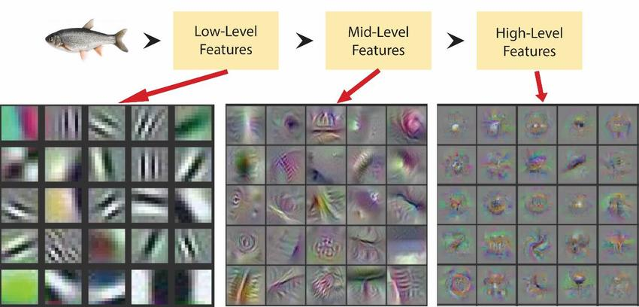
Why does pretraining work?

Slide 39
Why does pretraining work?
The Conv Layers are for feature extraction
The low-level feature (edges, shapes, patterns, etc.) learned from ImageNet are effective to other image problems.
The high-level features learned from ImageNet are useful, but less effective.
Think of the top FC Layers as a classifier which takes the extracted features as input
Less trainable parameters, less prone to overfitting
Low-level features
High-level features
Classifier (e.g., Softmax, Logistic, SVM, etc.)

Slide 40
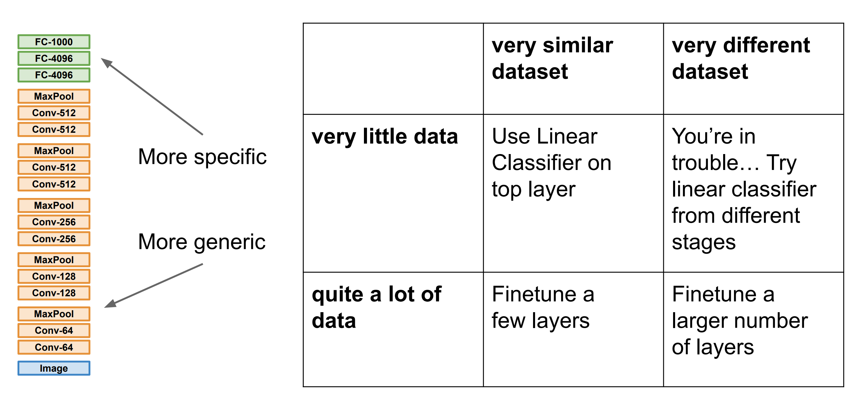

Slide 41
Summary of the Results
A small ConvNet
Training Accuracy: 100.00%
Testing Accuracy: 76.51%
A small ConvNet + Dropout
Training Accuracy: 96.59%
Testing Accuracy: 78.96%
A small ConvNet + Dropout + Data Augmentation
Training Accuracy: 82.04%
Testing Accuracy: 82.86%
Pretrain ResNet18 + Finetune Top Layer
Training Accuracy: 97.84%
Testing Accuracy: 98.10%

Slide 42
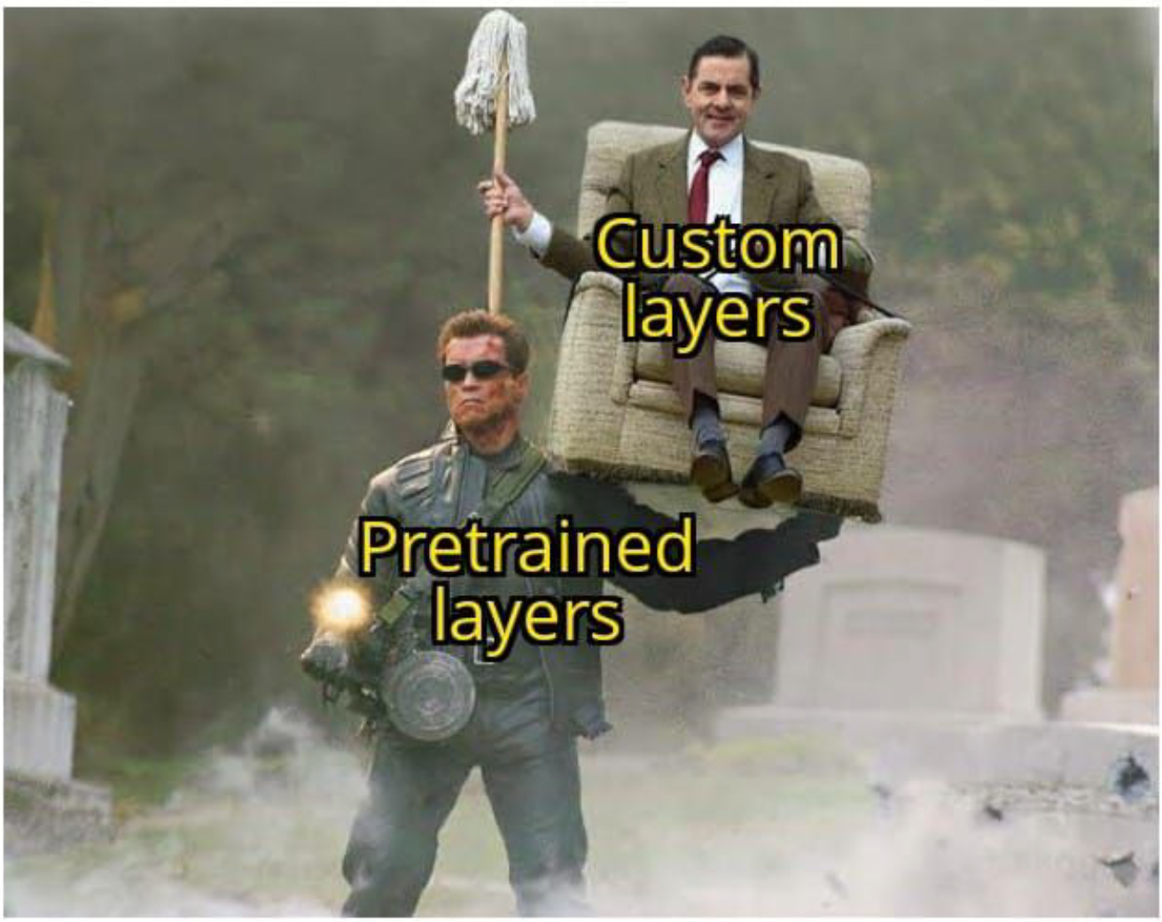
Takeaway for your homework and beyond

Slide 43
Announcement
Office hour today will be from 4:30 pm to 6:00 pm.

Slide 44
Ensemble Methods

Slide 45
Ensemble Methods
Varying data (bagging)
Fit a VGG16 network on a subset of data → Model 1
Fit a VGG16 network on a subset of data → Model 2
Fit a VGG16 network on a subset of data → Model 3

Slide 46
Ensemble Methods
Varying data (bagging)
Fit a VGG16 network on a subset of data → Model 1→ pred 1
Fit a VGG16 network on a subset of data → Model 2→ pred 2
Fit a VGG16 network on a subset of data → Model 3→ pred 3
Vote

Slide 47
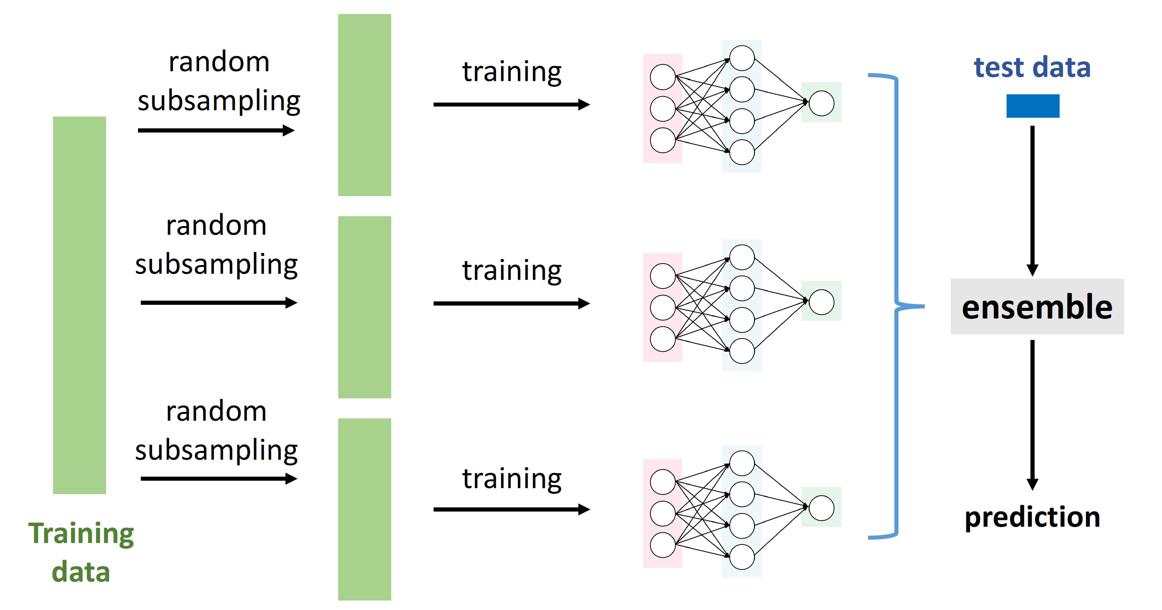
Bagging (aka Bootstrap Aggregating)

Slide 48
Ensemble Methods
Varying data (bagging)
Fit a VGG16 network on a subset of data → Model 1→ pred 1
Fit a VGG16 network on a subset of data → Model 2→ pred 2
Fit a VGG16 network on a subset of data → Model 3→ pred 3
Varying models
Different network structures
Different random initializations
Different optimization algorithms
Vote

Slide 49
Why Ensemble?
Deep neural networks are unstable
Sensitive to hyper-parameters

Slide 50
Why Ensemble?
Deep neural networks are unstable and random
Sensitive to hyper-parameters
Random initialization
Stochastic gradient
Different local optima

Slide 51
Why Ensemble?
Deep neural networks are unstable and random
Sensitive to hyper-parameters
Random initialization
Stochastic gradient
Ensemble method reduces variance
Different local optima

Slide 52
Multi-Task Learning

Slide 53
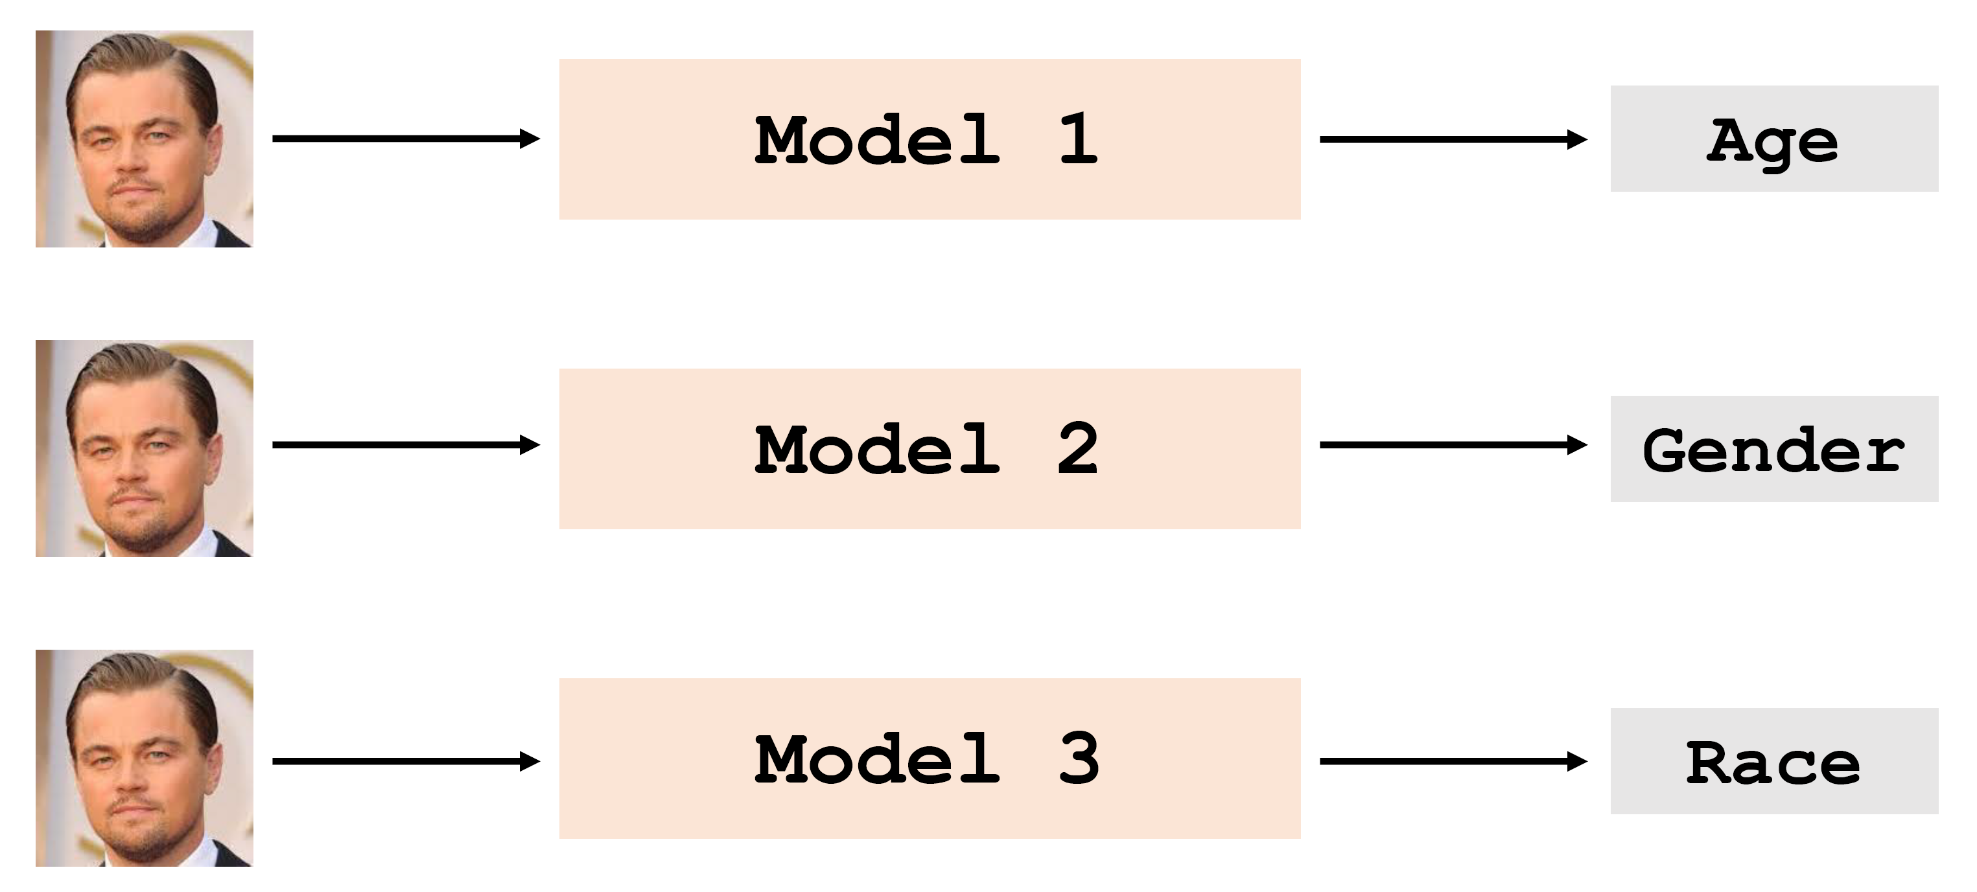
Without Parameter Sharing

Slide 54
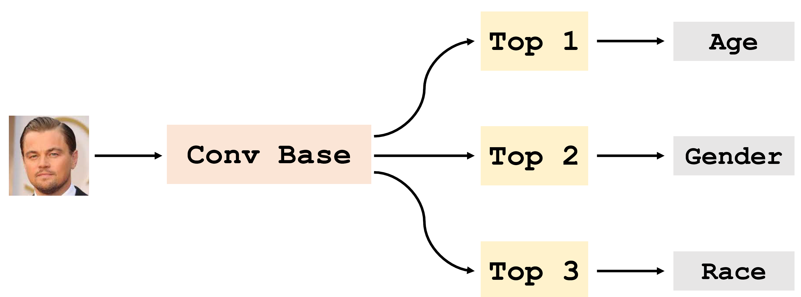
Multi-Task Learning

Slide 55
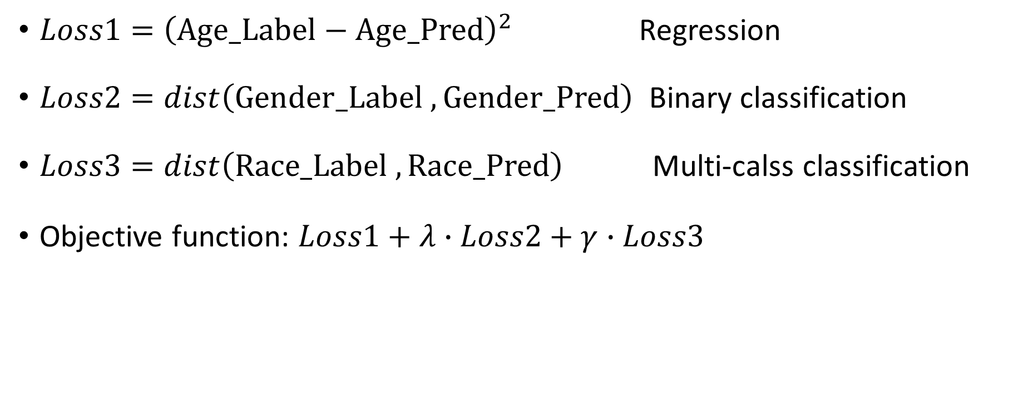
Multi-Task Learning
$Loss1={\left(Age_Label−Age_Pred\right)}^{2}$ Regression
$Loss2=dist\left(Gender_Label ,Gender_Pred\right)$ Binary classification
$Loss3=dist\left(Race_Label ,Race_Pred\right)$ Multi-calss classification
Objective function: $Loss1+λ∙Loss2+γ∙Loss3$

Slide 56
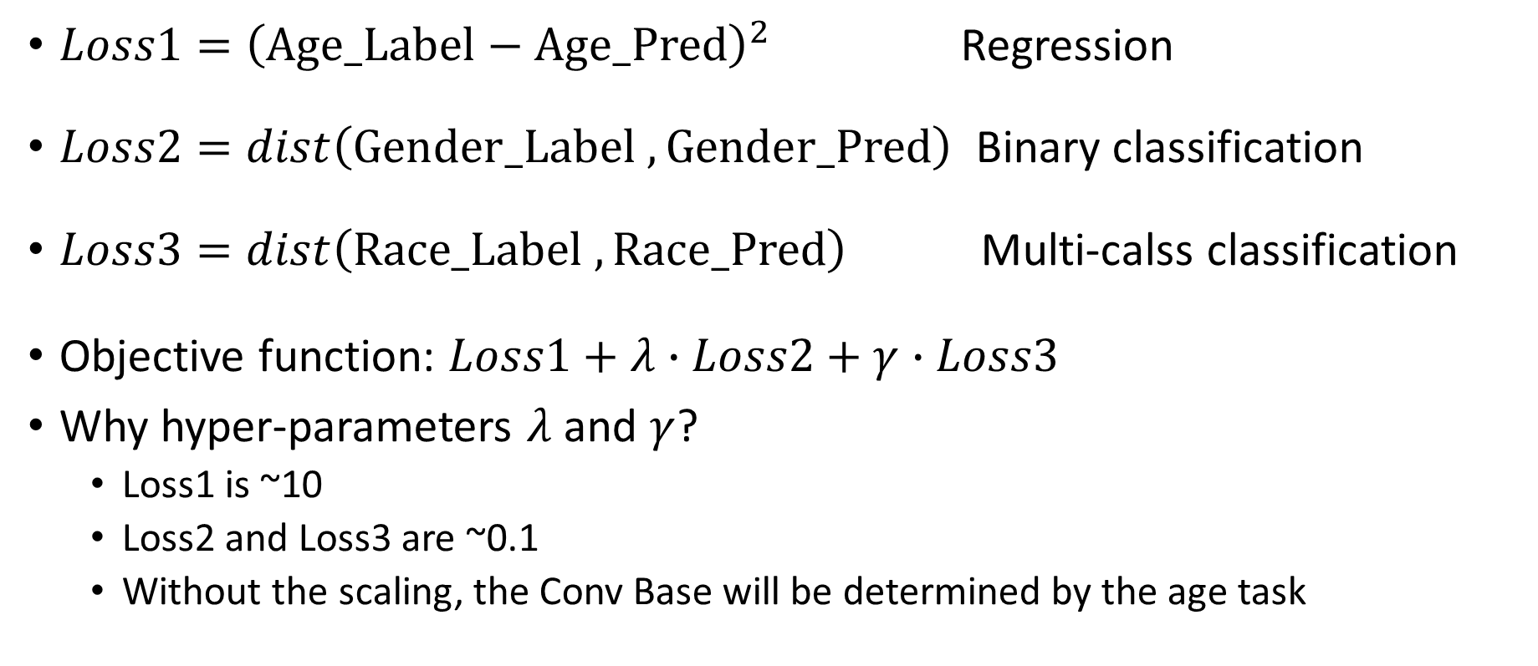
Multi-Task Learning
$Loss1={\left(Age_Label−Age_Pred\right)}^{2}$ Regression
$Loss2=dist\left(Gender_Label ,Gender_Pred\right)$ Binary classification
$Loss3=dist\left(Race_Label ,Race_Pred\right)$ Multi-calss classification
Objective function: $Loss1+λ∙Loss2+γ∙Loss3$
Why hyper-parameters $λ$ and $γ$?
Loss1 is ~10
Loss2 and Loss3 are ~0.1
Without the scaling, the Conv Base will be determined by the age task

Slide 57
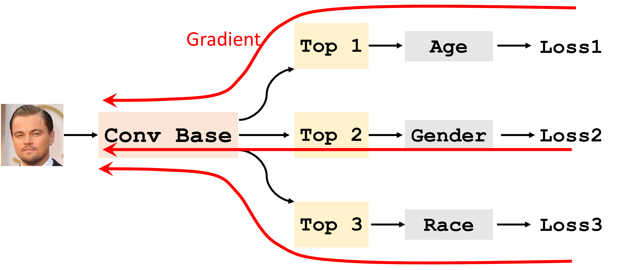
Multi-Task Learning

Slide 58
Summary: Tricks for Better Generalization
Trick 1: Dropout regularization
Trick 2: Data augmentation
Trick 3: Pretrain
Trick 4: Ensemble methods
Trick 5: Multi-task learning

